Slide 1

Macbeth
Act 4

Slide 2
Act 4, Scene 1
The witches chant and dance around a bubbling cauldron, brewing a spell. Macbeth enters their cave demanding that they answer his questions; in fact, he would prefer that the universe be turned to chaos rather than be denied what he wants to know.
Three apparitions appear:
A severed head wearing a battle helmet.
A blood covered child.
A child wearing a crown and carrying a tree.
They tell Macbeth to beware of Macduff; that he will not be killed by anyone born of woman.
His insistent demand about Banquo’s descendants are answered by a parade of apparition-kings, each resembling Banquo. He swears to kill Macduff’s family.

Slide 3
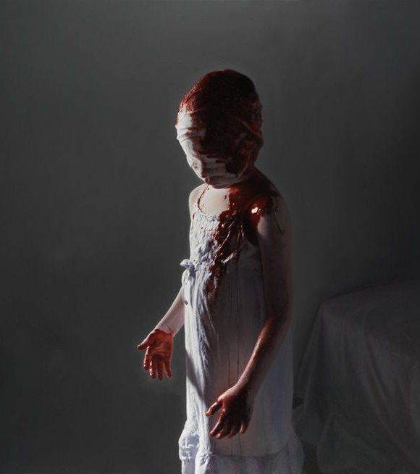
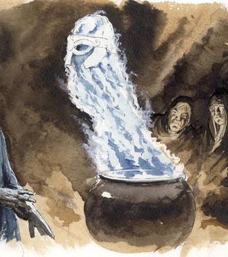
Act 4, Scene 1
[Thunder. First apparition: an armed Head]…”Macbeth! Macbeth! Macbeth! beware Macduff. Beware the thane of Fife. Dismiss me: enough.” [Descends]
[Thunder. Second apparition: a bloody Child] … “Macbeth! Macbeth! Macbeth!... Be bloody, bold and resolute; laugh to scorn / The power of man, for none of woman born / Shall harm Macbeth.” [Descends]
[Thunder. Third apparition: a Child crowned, with a tree in his hand] “…Be lion-mettled, proud, and take no care / Who chafes, who frets, or where conspirers are: / Macbeth shall never vanquish’d be until / Great Birnam wood to high Dunsinane hill / Shall come against him.” [Descends].

Slide 4
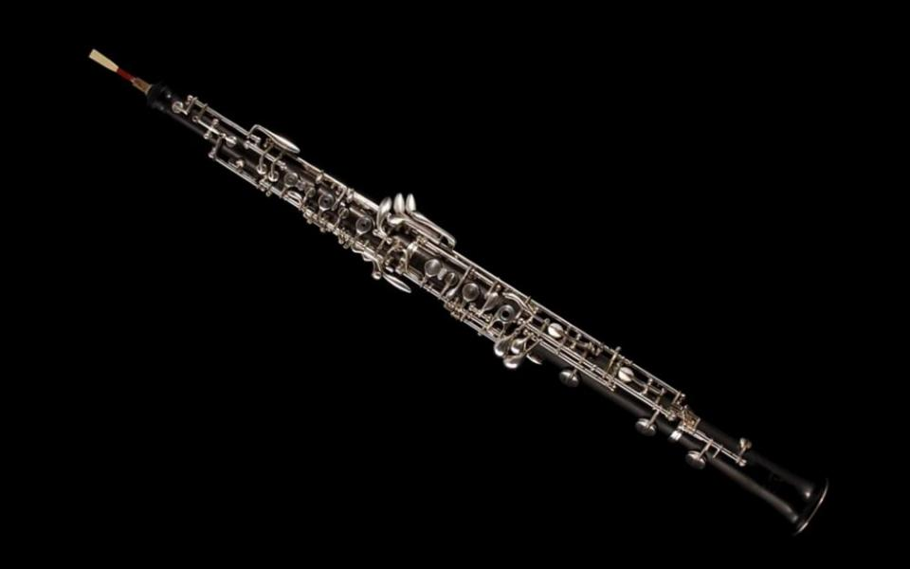
Visuals and sound in Macbeth
In Act 4, Scene 1 [Hautboys] play at important moments. In this scene, we have thunder, stage directions of rising apparitions out of a cauldron, and the sound of hautboys (oboes). The oboe is associated with doom (ominous oboes!).
Consider how the use of thunder, darkness, oboes and apparitions builds a truly terrifying scene.
The hautboys play as the cauldron produces eight apparitions of Kings, following by the ghost of Banquo, signifying the prophecy of Banquo’s descendants becoming the king of Scotland.
Ominous Oboes (shakespeare.org.uk)

Slide 5
Tragedy in Macbeth
At this point, Macbeth has truly started losing it.
In tragedies, the hero has a fatal flaw or hamartia.
What is Macbeth’s hamartia?
We could describe Victor Frankenstein’s ambition and behaviour as hubris – prideful and arrogant. Macbeth is neither prideful or arrogant. What is the impact of this characterisation?
Create a timeline of Macbeth’s characterisation over the course of the play using adjectives to describe him at different points.

Slide 6
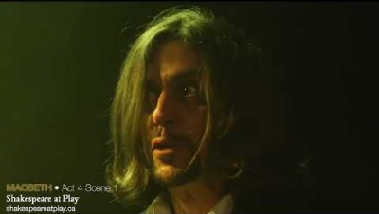
A much weirder version of this scene: Something Wicked This Way Comes | Macbeth - YouTube

Slide 7
Act 4, Scene 2
What, you egg?

Slide 8
Act 4, Scene 3
Macduff goes to England to ask Malcolm to come save everyone’s butt (invade Scotland).
Malcom tries to prank Macduff by saying he’d be corrupt, greedy, lecherous and vicious. Luckily he was ”totally kidding” and, after seeing Macduff’s horror and withdrawal, trusts Macduff’s integrity and agrees to help.
Malcolm then says King Edward is pious and virtuous and can heal those afflicted with tuberculosis with just a touch!
Macduff then finds out his whole family is dead and the manliest option is to go and kill Macbeth instead of seeking grief counselling.

Slide 9
Important lines
Malcom: “Merciful heaven! / What, man! ne’er pull your hat upon your brows; / Give sorrow words: the grief that does not speak / Whispers the o’er-fraught heart, and bids it break.”
Macduff: “He has no children. All my pretty ones? / Did you say all?” He could be referring to Malcolm, who has no children and therefore cannot understand his grief.
Malcolm: “Dispute it like a man.”
Macduff: “I shall do so; / But I must also feel it as a man…” he blames himself for his family’s death – heaven did not prevent the slaughter.
Macduff: “O, I could play the woman with mine eyes… Within my sword’s length set him;”
Malcom: ”This tune goes manly.”
Manhood and emotions

